Slide 1

The Food System
Here is where your presentation begins

Slide 2
Table of contents
01
02
03
04
05
06
About us
JWT
Authentication
Restaurant admin dashboard
Viewing Restaurants
App owner dashboard
System architecture

Slide 3


01
About us

Slide 4

Our Team
Welcome to the .NET Developer Team at ITI! We are a group of skilled developers who are passionate about building web applications that are efficient, user-friendly, and visually appealing. Our mission is to create a web application that is similar to popular fast-food applications like Talabat and elmenus, by integrating Web APIs and Angular.

Slide 5

JWT Authentication
What is JWT (JSON Web Token)?
Is a good way of securely transmitting information between parties as JSON such as share information between two entities :
Client (app’s frontend)
Server ( app’s backend)

Slide 6

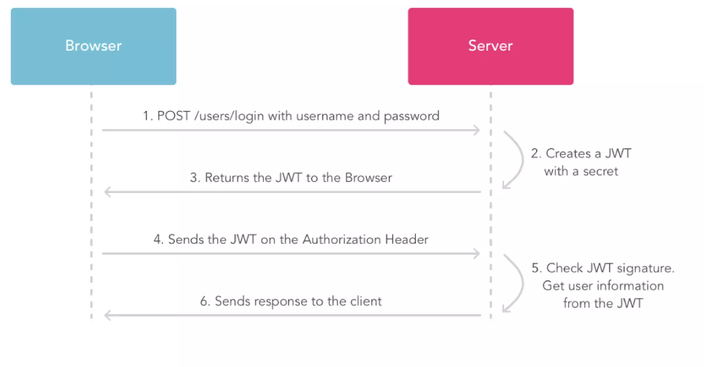
JWT Authentication Workflow
The authentication server verifies the credentials and issues a JWT signed using a private key.
Moving forward, the client will use the JWT to access protected resources by passing the JWT in the HTTP Authorization header
User sign-in
The resource server then verifies the authenticity of the token using the public key

Slide 7
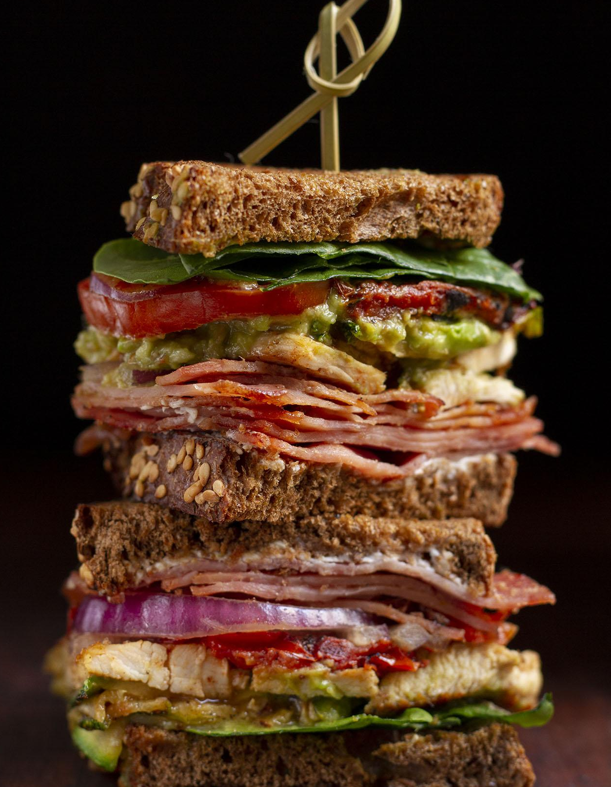
JWT Structure
01
02
0
A JWT contains three parts:
1. Header: Consists of two parts:
The signing algorithm that’s being used.
The type of token, which, in this case, is mostly “JWT”.
2. Payload: The payload contains the claims or the JSON object.
3. Signature: A string that is generated via a cryptographic algorithm that can be used to verify the integrity of the JSON payload.

Slide 8

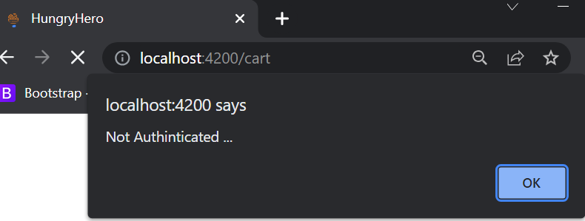
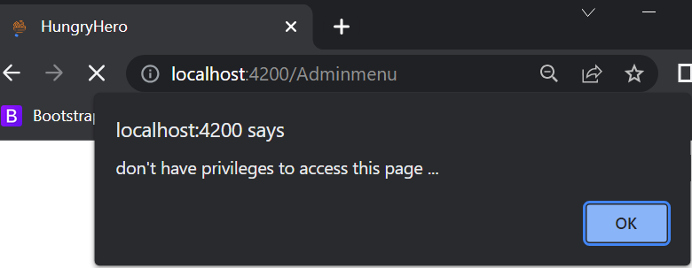
Route Guards
What Are Route Guards?
Angular route guards are interfaces provided by Angular which, when implemented, allow us to control the accessibility of a route based on conditions provided in class implementation of that interface.
Route guards have two types
1. Can Activate :
use this guard to prevent access to users who are not authorized to access a route

Slide 9
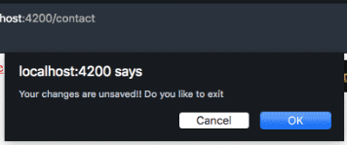
2. Can Deactivate :
Use this to prevent a user from leaving a page.
This is often helpful when a user is leaving the page before saving the data.

Slide 10
Restaurant Admin Dashboard
Restaurant Admin Dashboard is allow Restaurant Admin to add ,edit ,delete and show all items in this Restaurant
Feature
Adding items | Restaurant admin can add items to menu in own Restaurant by clicking on a button (Add product)
Edit items | Restaurant admin can edit items from menu in own Restaurant by clicking on icon edit
Delete items | Restaurant admin can delete items from menu in own Restaurant by clicking on icon delete
Show items | Restaurant admin can view all items on his dashboard

Slide 11
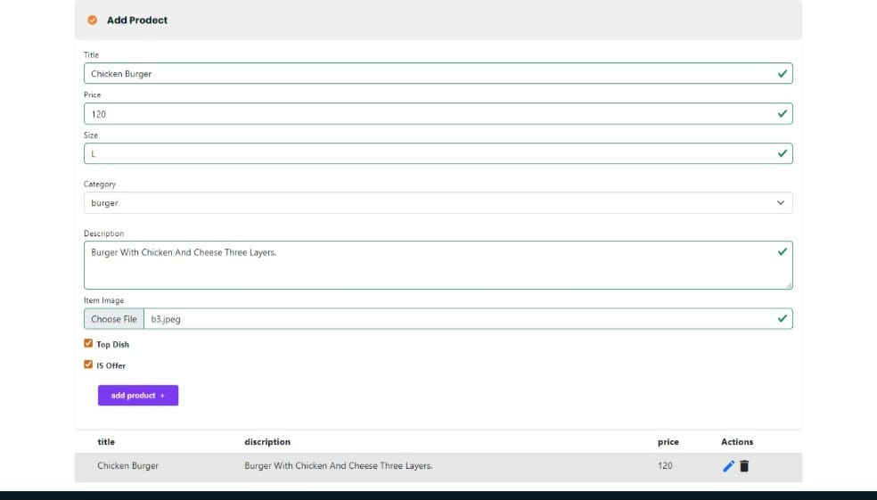
Add menu item

Slide 12
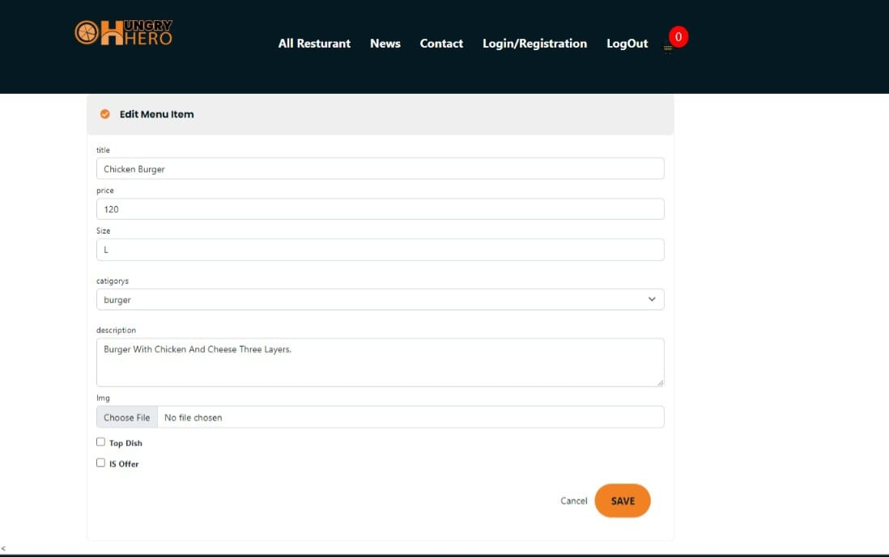
Edit menu item

Slide 13
All Restaurant
Feature
View all restaurant | Customer can view all Resturant
search | Customer can search for a specific restaurant by writing his name in search

Slide 14
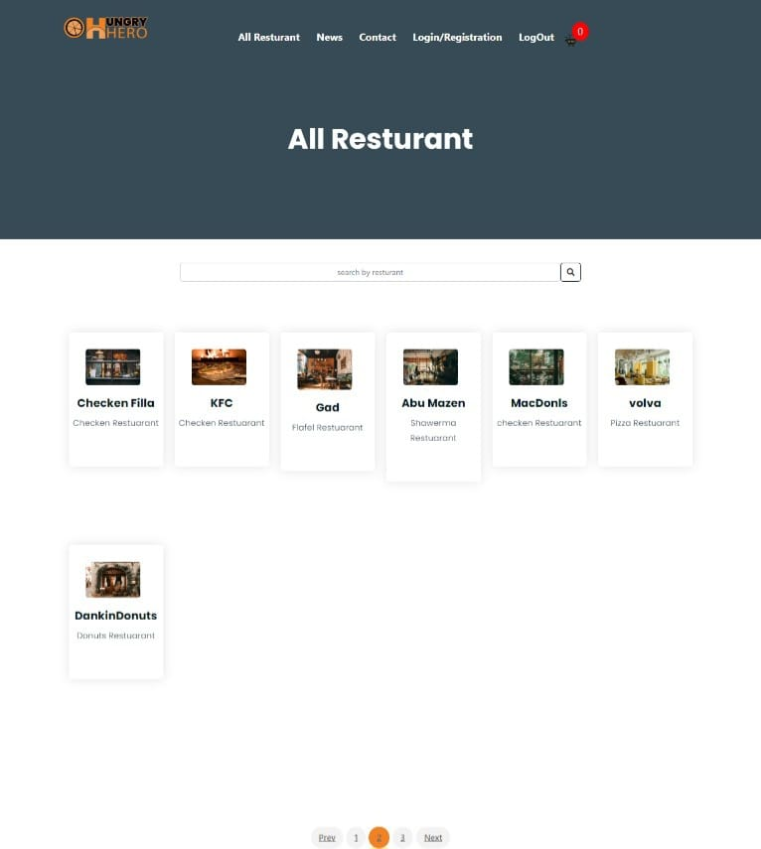
All Restaurants

Slide 15
Menu item
Feature
View menu | Customer can view Restaurant menu by clicking on specific Restaurant
Filter by Category name | Customer can view items of a specific category by selecting category name
View Top Dishes | Customer can view top menu of specific Restaurant
View Offers | Customer can view items which have offer of specific Restaurant

Slide 16
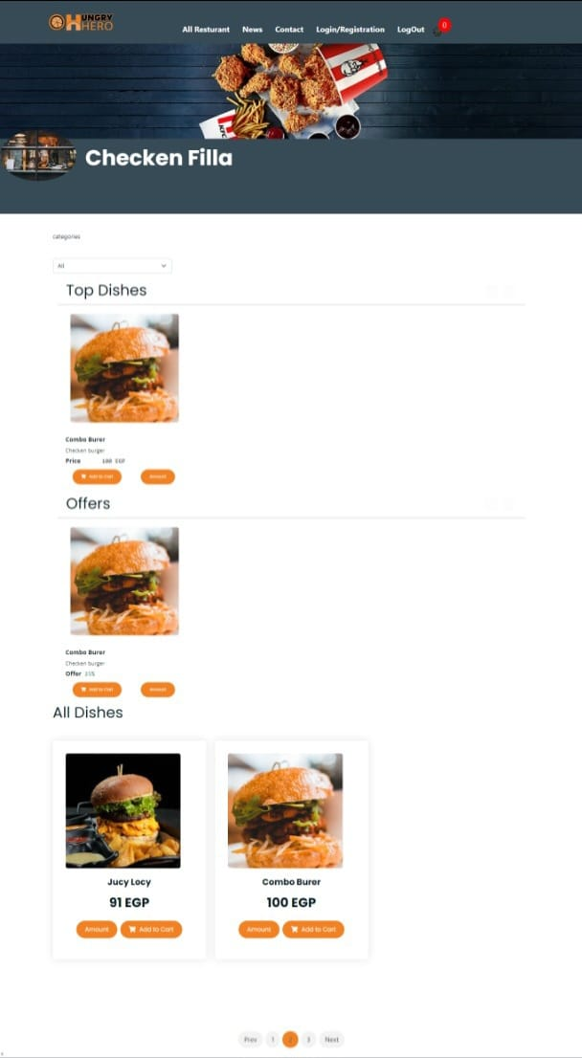
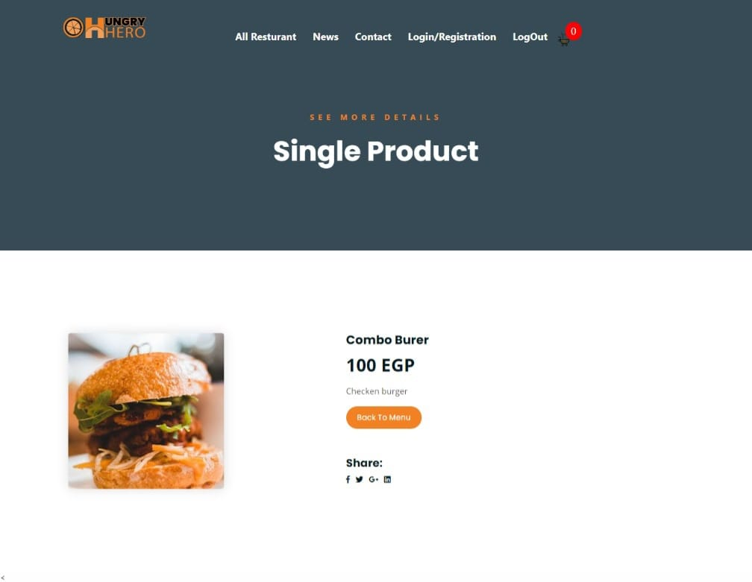

Slide 17

App Owner

Slide 18
App owner responsibilities
as an app owner of a multi-vendor food system, it is important to ensure that the menu items offered by each vendor meet certain standards before accepting them onto the platform. This is because as the owner of the platform he is responsible for the customer experience and ensuring that the food being sold on the platform is safe, high-quality, and meets customer expectations
As a multi-vendor food system, you are responsible for accepting or rejecting restaurant owners who attempt to join your platform

Slide 19
appOwner Features
View the menuItems | App Owner can view all the menu items before publishing on the system.
Viewing restaurant owner | App owner can view the all the res admins who tries to register.
Accept items | App owner can accept the items.
Removing items | App owner can remove the items.
Accept res admin | App owner can accept the res admin .
Delete res admin | App owner can remove the items.

Slide 20
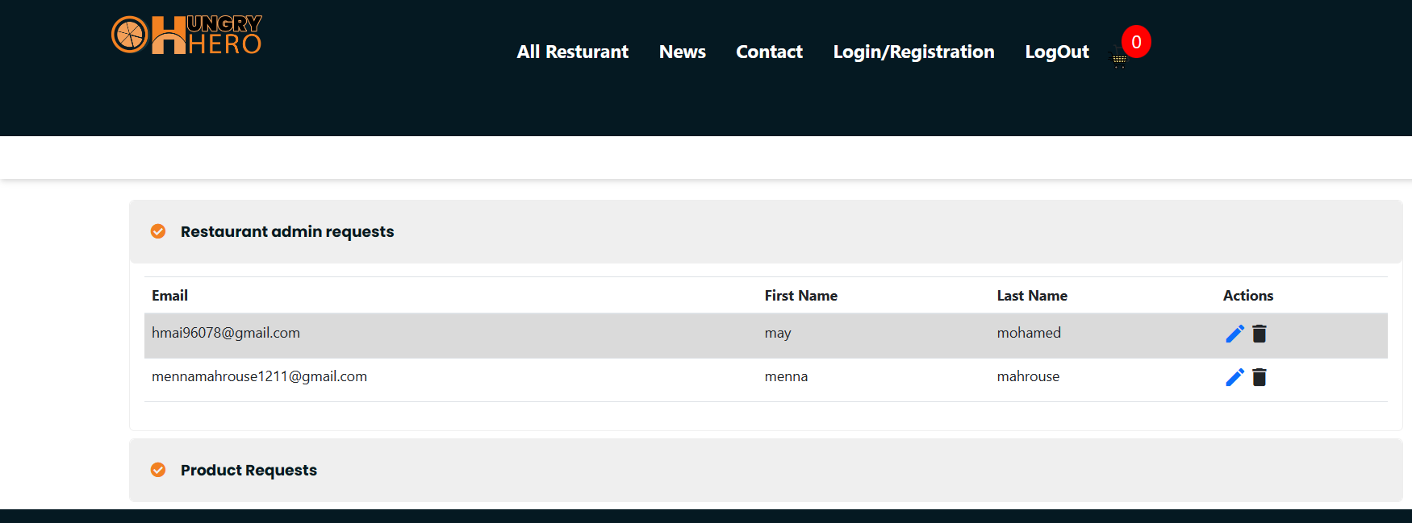
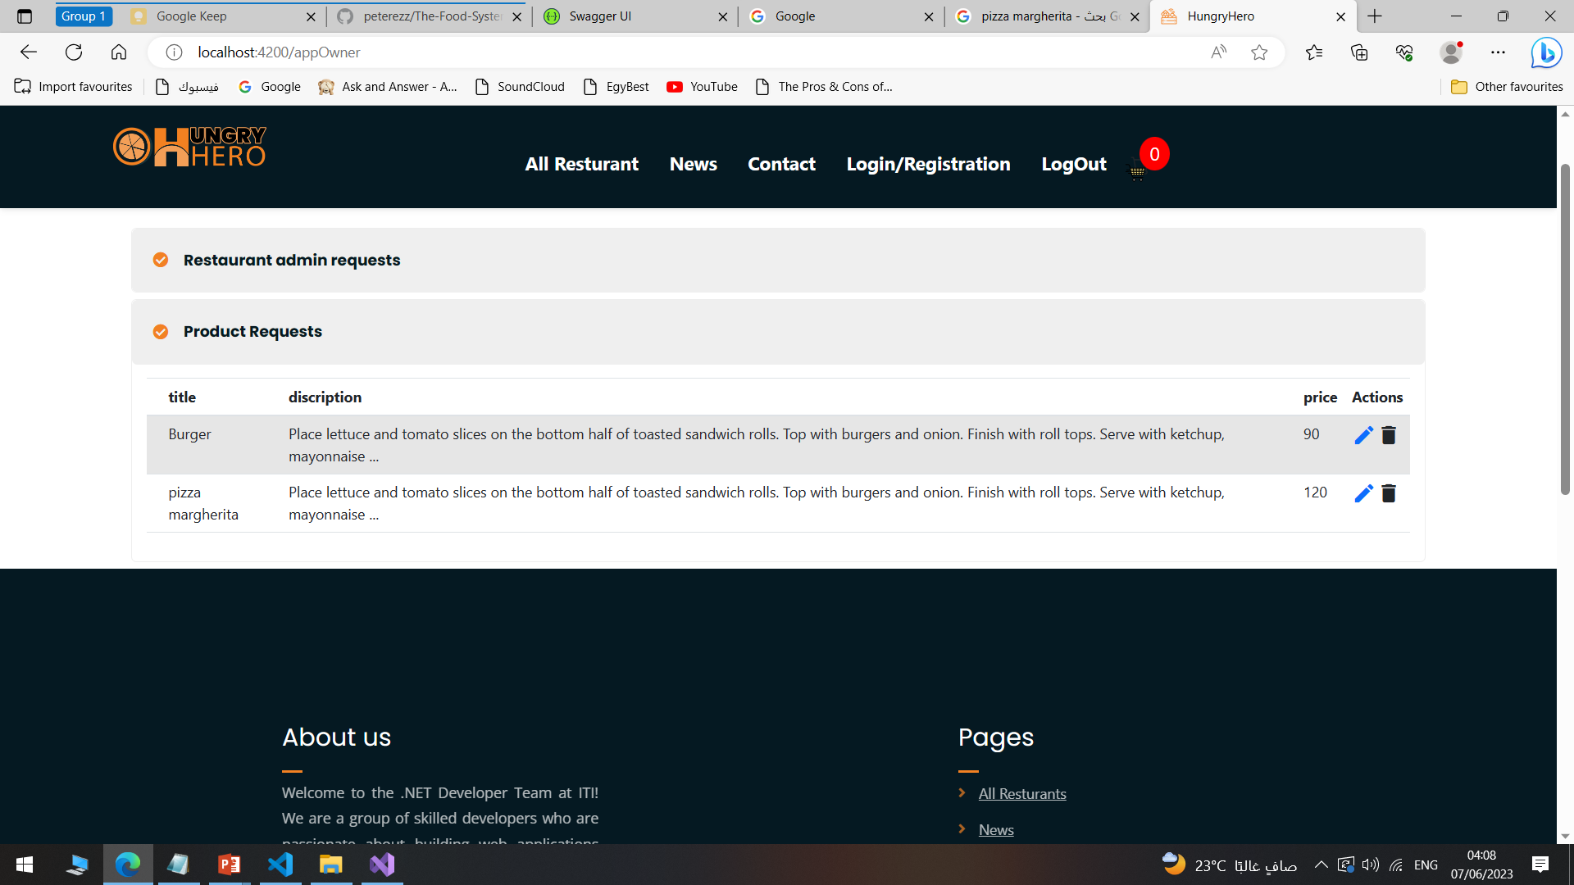
Manage ResAdmin & MenuItem

Slide 21
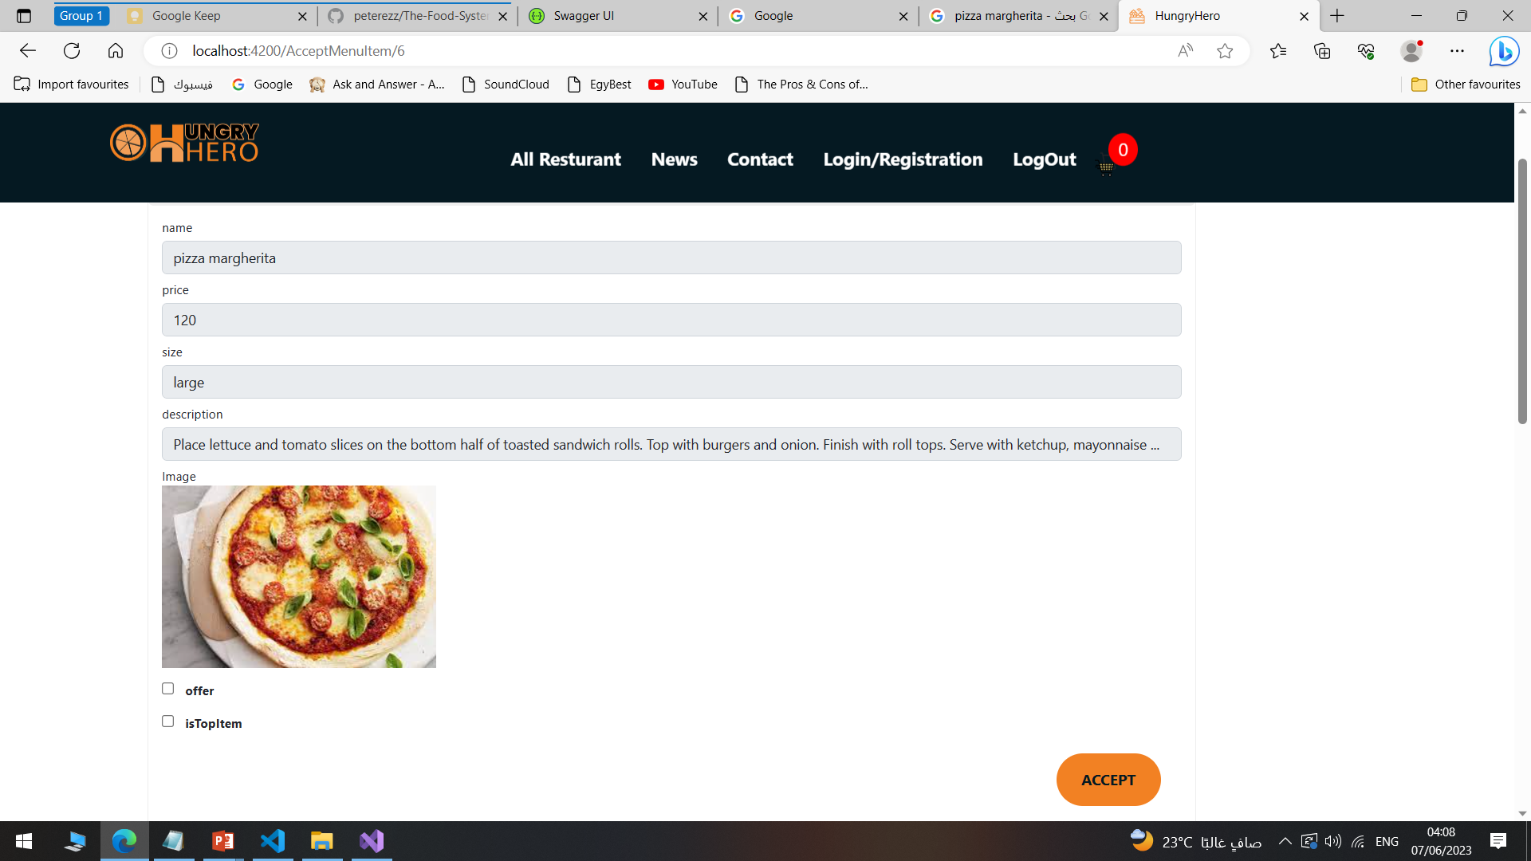
View a MenuItem & Accept it

Slide 22
Cart Component
The cart component is responsible for displaying the items in the cart and allowing the user to perform actions on them
Cart Properties
Cart Items : An array of objects representing the items in the cart. Each object should have the following properties
Dish : The dish details, including name, price, and any other relevant information
Quantity : The quantity of the item in the cart

Slide 23
Cart Feature
Adding items | Customers can add items to the cart by clicking on a button or icon associated with the item
Viewing cart | Customers can view the contents of the cart. This usually displays a summary of the items in the cart, along with the subtotal and any applicable taxes or shipping fees.
Updating items | Customers can update items in the cart by changing the quantity
Removing items | Customers can remove items from the cart
Remove All | clears all items from the cart and local storage
Checkout | Customers can initiate the checkout process online by using PayPal or on delivery

Slide 24
Using local storage to store cart data and benefits for the user
Real-time Updates
Live events allow the UI to be updated in real-time when the cart is modified
Reduced Server Load
Live events reduce the need for the server to constantly check for updates to the cart. This reduces server load and improves website performance
Speed
Local storage is faster than making API calls to the server every time the user adds, updates, or removes an item from the cart. This improves the user experience by reducing the amount of time it takes to perform these actions

Slide 25

System architecture

Slide 26
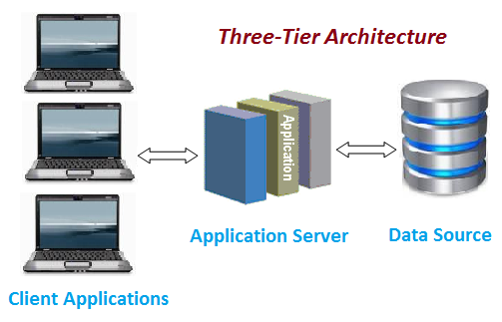
Three tire architecture
A three-tier architecture is a client-server architecture in which the functional process logic, data access, computer data storage and user interface are developed and maintained as independent modules on separate platforms.

Slide 27
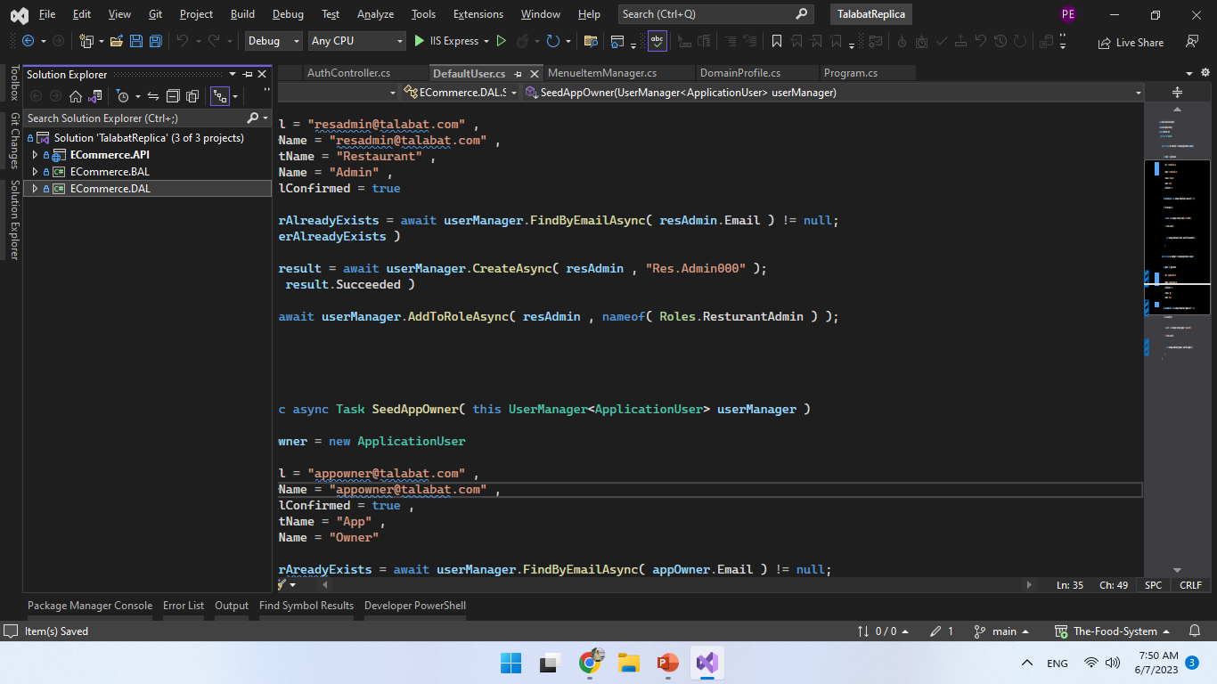
Code Sample

Slide 28
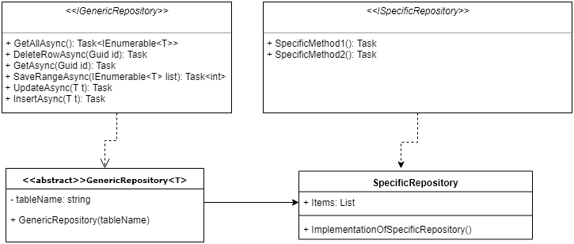
Generic Repository
Generic repository is simple contract defined as an interface on per object basis. That means that one repository object is related to one table in database.
Generic repository UML diagram:

Slide 29
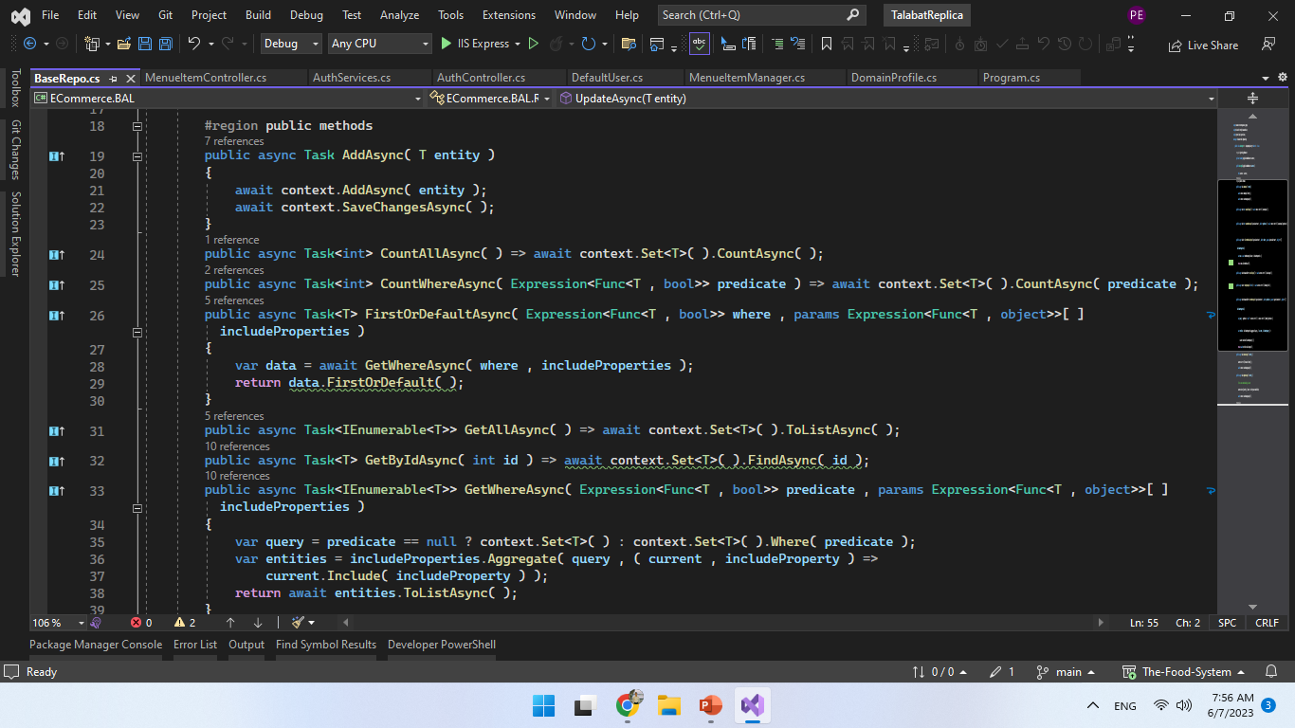
Code Sample

Slide 30
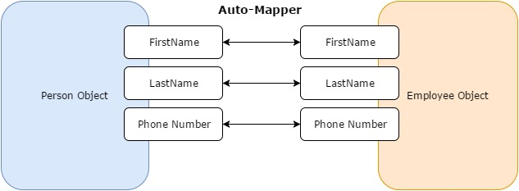
Automapper
AutoMapper in C# is a library used to map data from one object to another in web development. It acts as a mapper between two objects and transforms one object type into another.

Slide 31
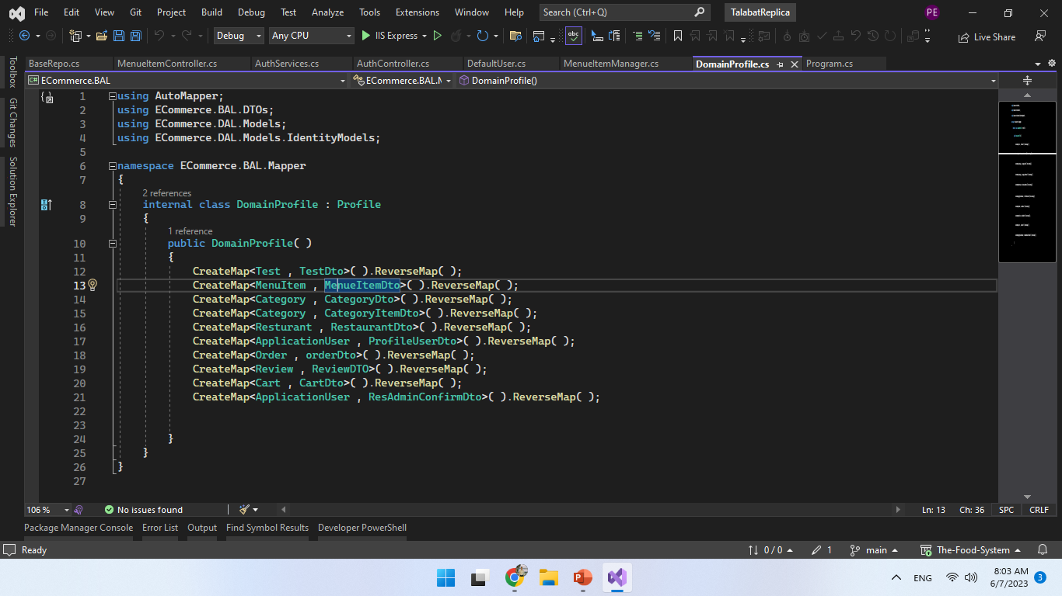
Code Sample

Slide 32

A picture is worth a thousand words

Slide 33

Thanks!
Please keep this slide for attribution

